Slide 1
Python Projects in Applied Statistics

Slide 2
Class Materials
Fork the Github repository
Fork the Kaggle kernel & Dataset

Slide 3
Introduction to Python
Installing Python (Anaconda) or Use on the fly kernel (e.g. kaggle)
Login to your kaggle account

Slide 4
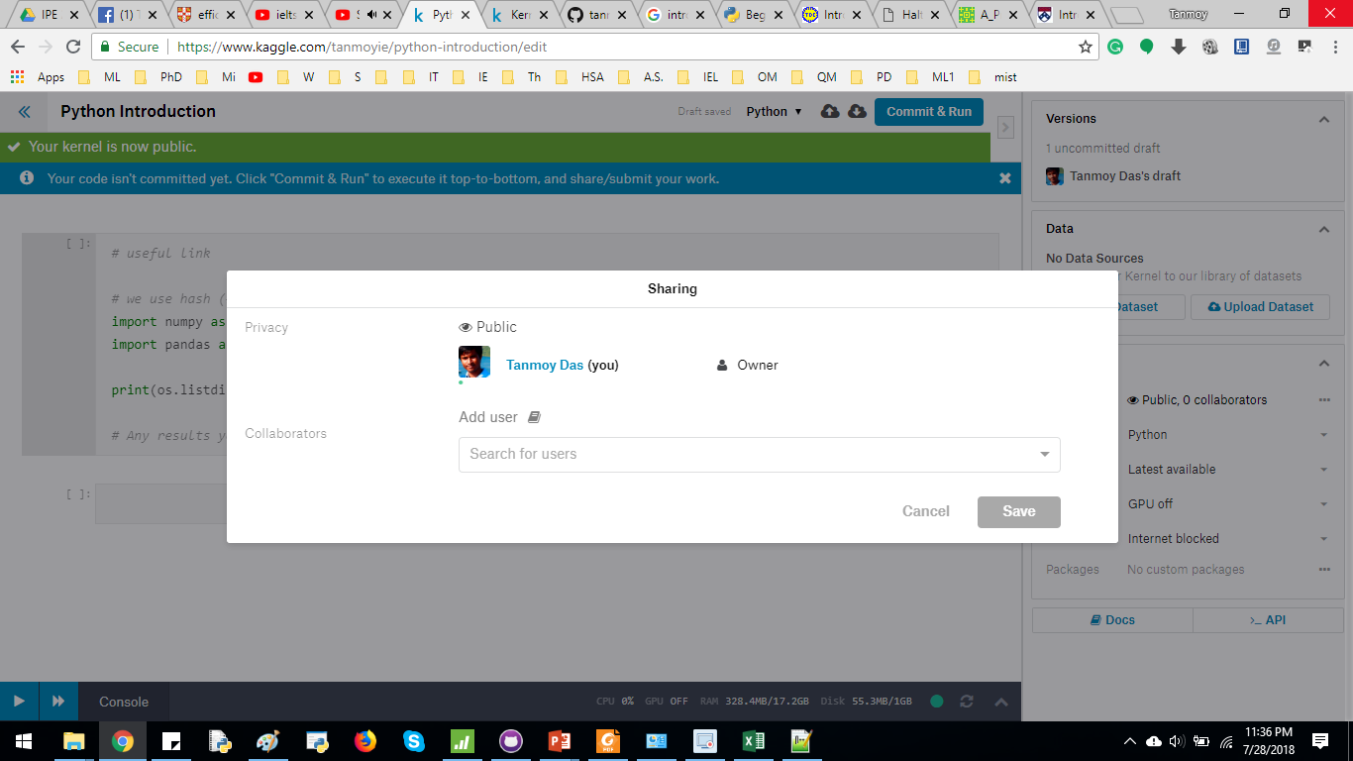
Introduction to Kaggle kernel
Once logged in, click KERNEL at the top right corner, then click NEW KERNEL
From the RIGHT side bar, make the KERNEL “public”. Add tanmoyie as an user/contributor

Slide 5
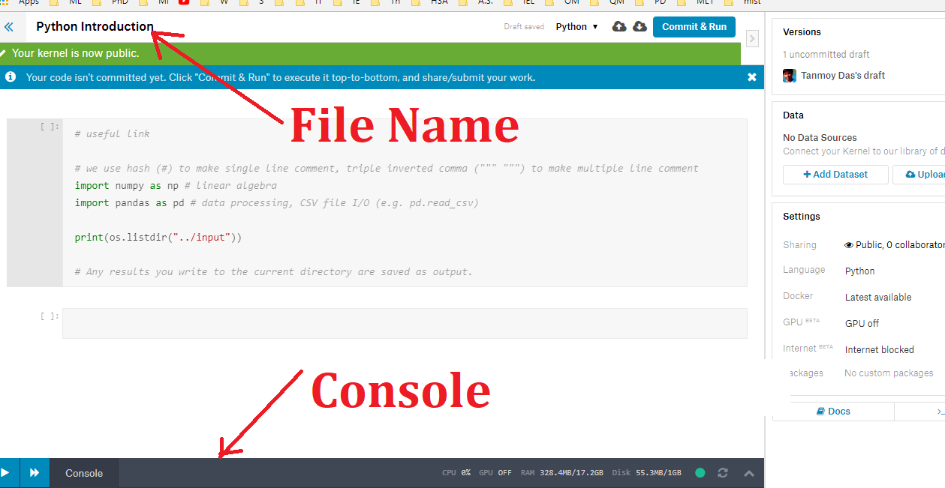
Introduction to Kaggle kernel
Name the file
There is a console in the bottom left corner

Slide 6
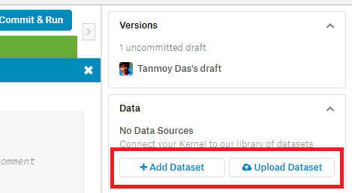
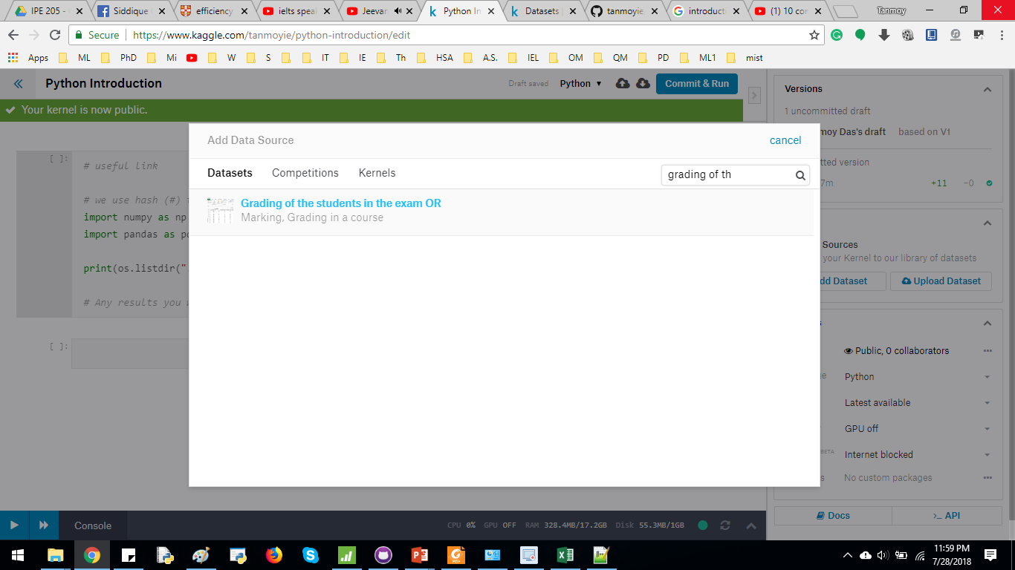
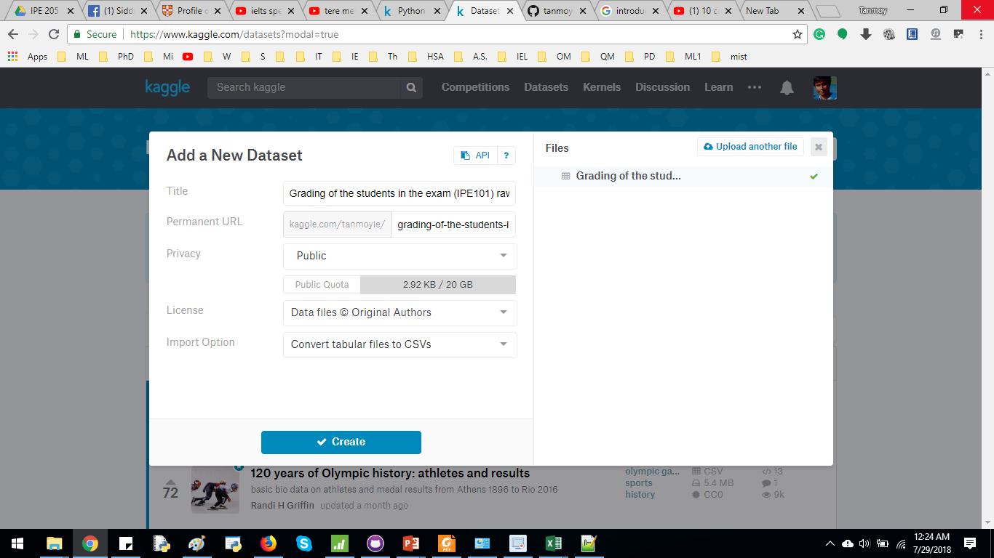
Introduction to Kaggle kernel
You can upload a new dataset from right hand side bar. Additionally, you can use someone else’s dataset (add Dataset)

Slide 7
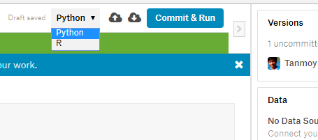
Introduction to Kaggle kernel
Select the Programming language (Python/R)
Commit & Run to run the entire program & make it visible to public.
2 Arrows to add cell above & below the current cell respectively.

Slide 8
Methodology
Data Import
Data Preprocessing
Cleaning
Imputation
Exploratory Data Analysis (EDA)
Develop graphical representation
Interpret the Data

Slide 9
Import an EXCEL file
Install pandas

Slide 10
Collect the Data
Show how I prepare the uploaded dataset
steps from EMS, copy+paste in new Excel file, processing, save as csv

Slide 11
Data Cleaning
Find empty cells or unnecessary cells
Delete unnecessary row/column
https://pandas.pydata.org/pandas-docs/stable/generated/pandas.DataFrame.dropna.html

Slide 12
Data Cleaning (if needed)
Removing unnecessary information
Data Imputation (if needed)
Handling NaN values

Slide 13
Data Visualization tools
Scatter Plot
Box Plot
Time series analysis
Bar graph
Histogram
Pie chart
Line graph
Dot plot
Stem & Leaf

Slide 14
Scatter plot
When we need to find the relationship between two variables, we may draw scatter plot
Finding whether the variables are correlated (positive, negative or no correlation)

Slide 15
Histogram
https://matplotlib.org/gallery/statistics/hist.html

Slide 16
Box Plot
Determining the percentiles

Slide 17
Bar graph
30% & 70% marks

Slide 18
Scatter Plot

Slide 19
Box Plot
https://matplotlib.org/api/_as_gen/matplotlib.pyplot.boxplot.html

